Slide 1
Weekly meeting 10
Shengya Guo, CR/AVS3, 11.09.2024

Slide 2
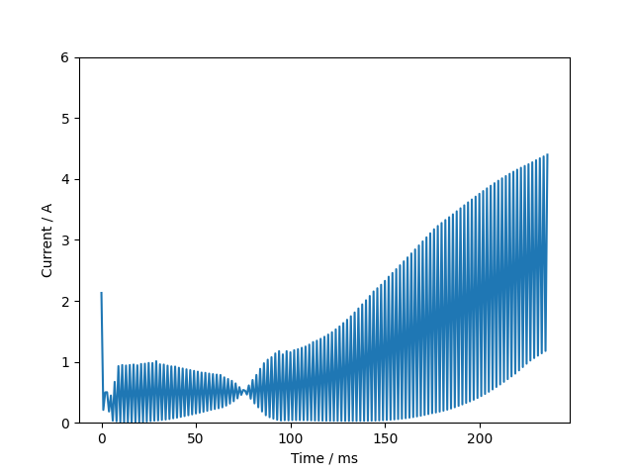
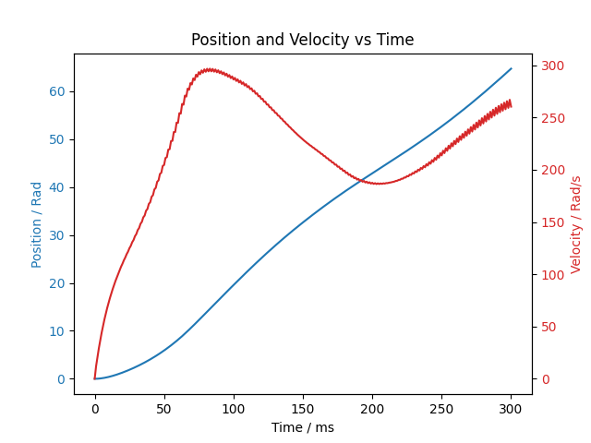
Result
Training with the secaled FIM

Slide 3
Problem with Observation normalization
The mean und var will loss when running the test episode after training
The test will continuous with the mean and var from the training, need to save this value and load them after load the mode

Slide 4
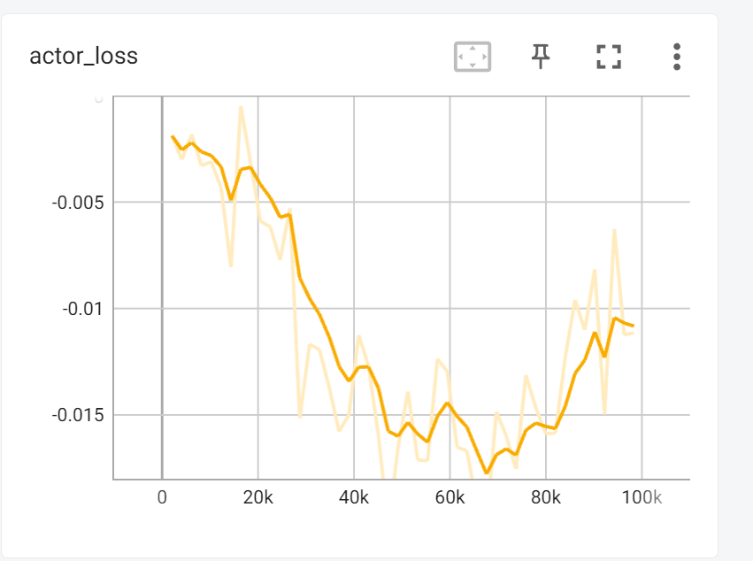
Problem with advantage normalization
mb_advantages = (mb_advantages - mb_advantages.mean()) / (mb_advantages.std() + 1e-8)

